Slide 1
Interesting Results in Chess
Edward Wu
Project Advisor: Professor Fernandez-Granda

Slide 2
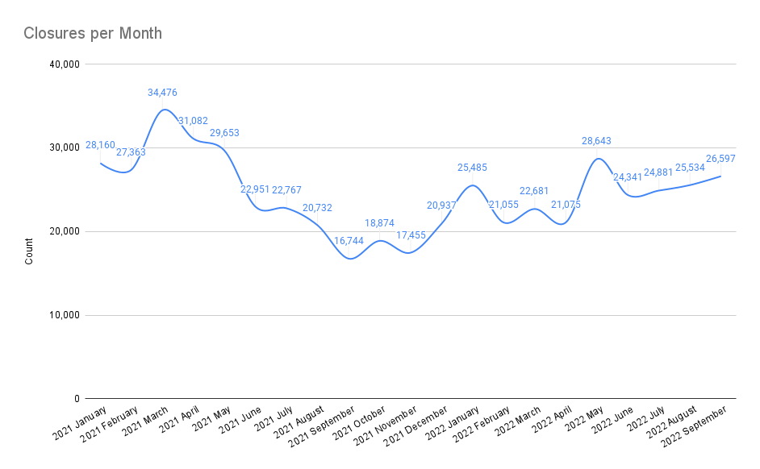
Source: https://www.chess.com/article/view/online-chess-cheating

Slide 3
Learning from AI
While AI can be used to cheat, it can also be used as a training partner. Players can use AI to:
Learn patterns about what best moves might look like in complex positions,
Perfect their play in openings and endgames, and
Formulate more precise plans and counterattacks.
None of these examples constitute cheating, as players are allowed to prepare lines and materials ahead of game time. They cannot bring materials to the board, but anything they remember can be used.
Source: https://www.theguardian.com/sport/2023/aug/28/magnus-carlsen-hans-niemann-chess-cheating-allegations-settlement

Slide 4
Searching for Data
High-quality & Had lots of relevant features
Plentiful & Had lots of observations
Accessible

Slide 5
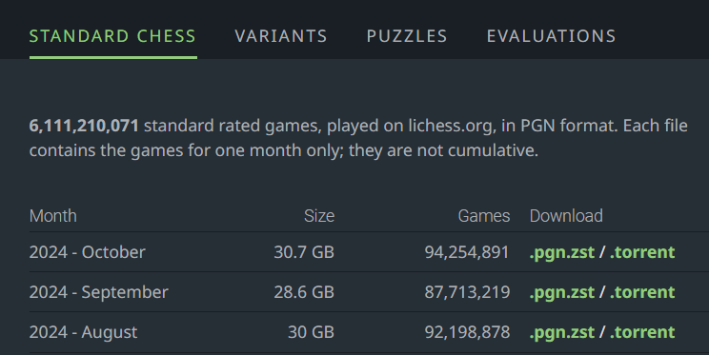

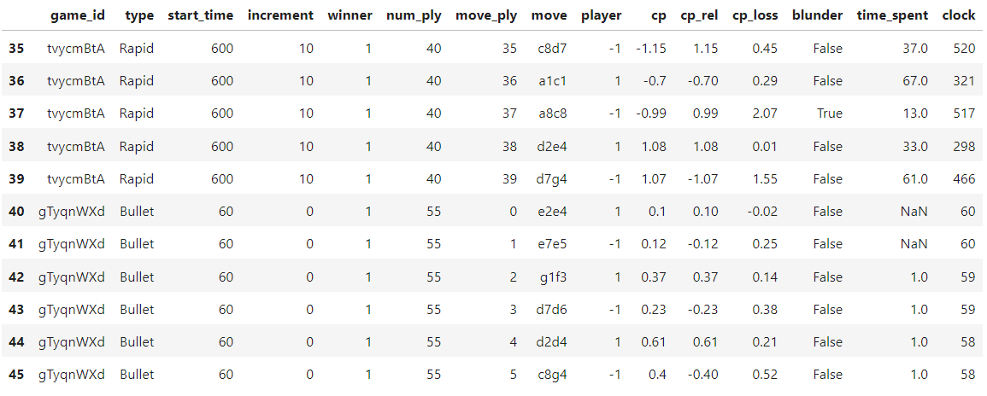
The
Data

Slide 6
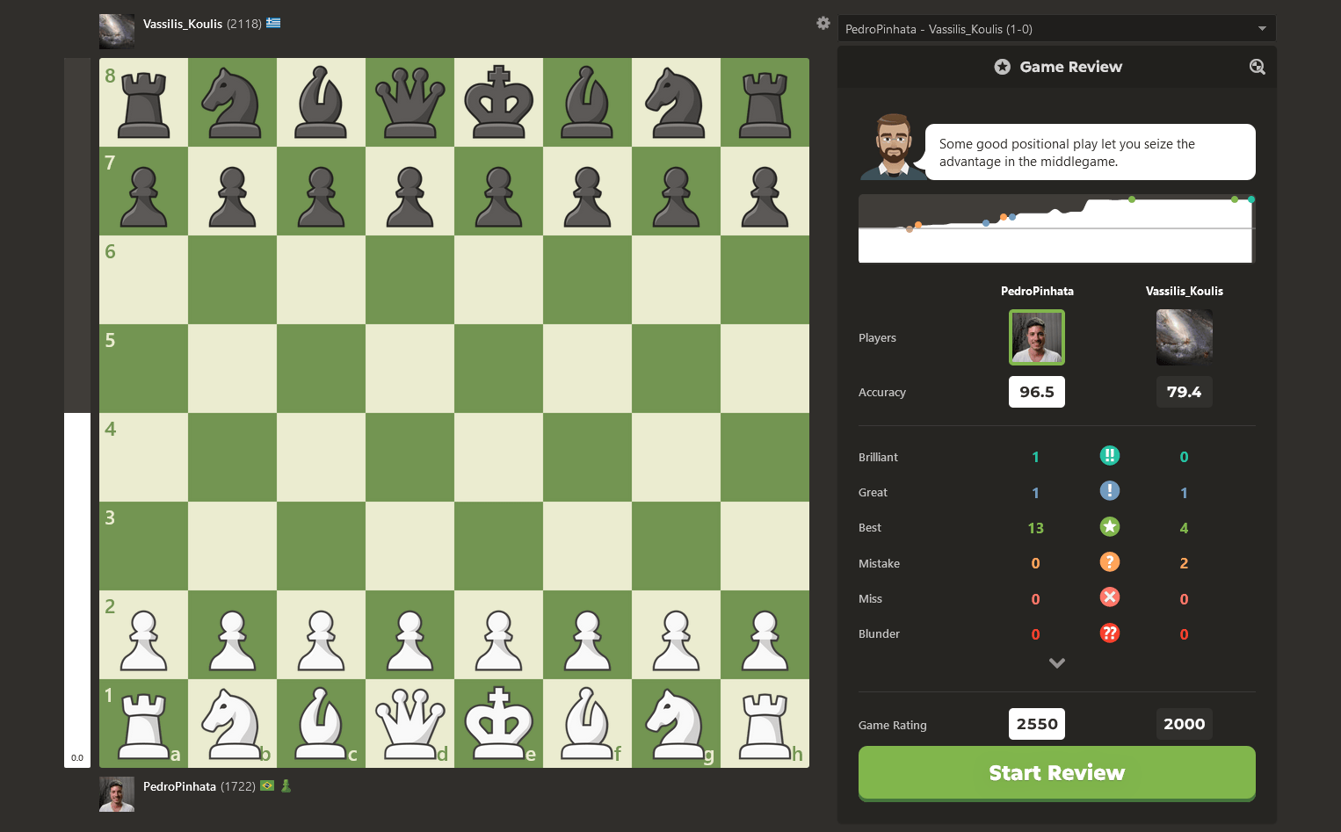
How can we Detect Cheating?
Source: https://www.chess.com/news/view/game-review-design-update

Slide 7
What can we use this data for?
To answer questions:
Do blunders end up following longer periods of thinking?
Does thinking longer tend to lead to better moves?
Do more experienced players spend more time thinking?
How often do players who make the first check win the game?
Are more experienced players more cautious with their pieces?
Is the amount of time that a player thinks correlated with the number of possible moves?

Slide 8
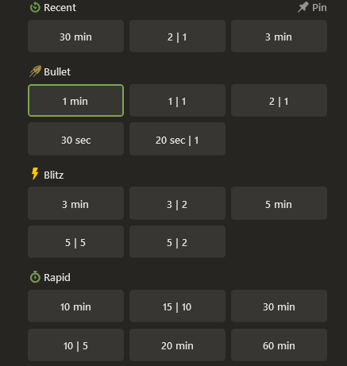
Time Control (Definition)
The time control of a game dictates how long players have to think on their moves.
Time control has two parts, the base time and the increment. The base time is the number of minutes that each player starts with. The increment is the number of seconds that each player gains after making a move, which helps avoid timeouts. For example, 5 | 2 means a base time of 5 minutes and an increment of 2 seconds.

Slide 9
Question 1:
How do the distributions of thinking time differ between moves that are blunders and moves that are not?

Slide 10
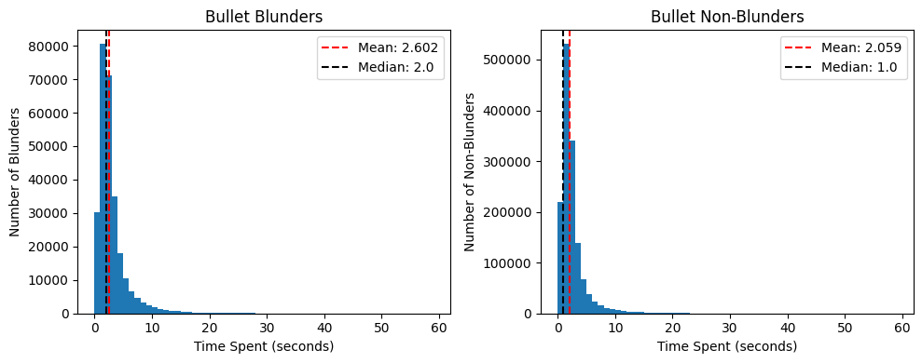
Question 1 - How do the distributions of thinking time differ between moves that are blunders and moves that are not?

Slide 11
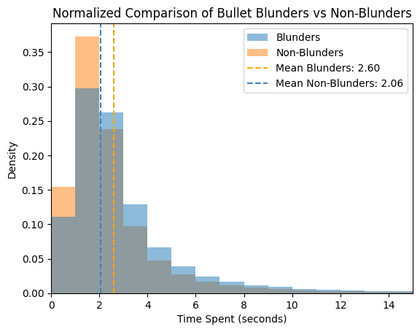
Question 1 - How do the distributions of thinking time differ between moves that are blunders and moves that are not?

Slide 12
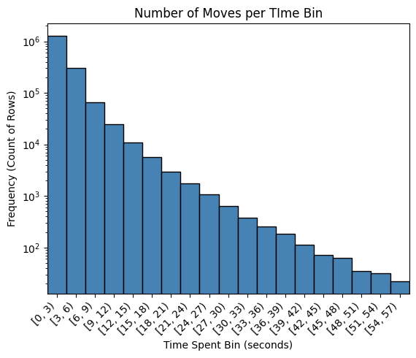
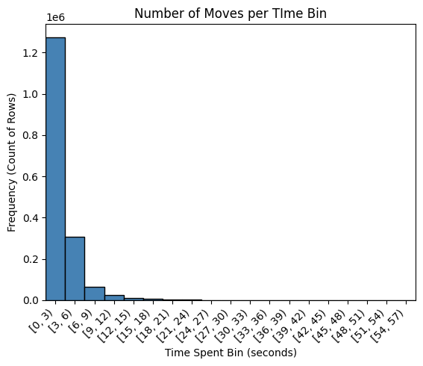
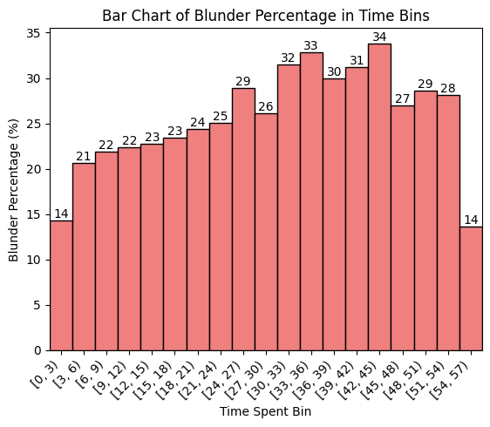
Question 1.1 - Given a time spent thinking, what is the likelihood that the resulting move is a blunder?

Slide 13
Some Possible Explanations
Positions that are more complex cause players to think more, but they are also harder to find the best move for.
Lower elo players make up the majority of the data, and they are responsible for this correlation.

Slide 14
Question 3:
Do more experienced players spend more time thinking?

Slide 15
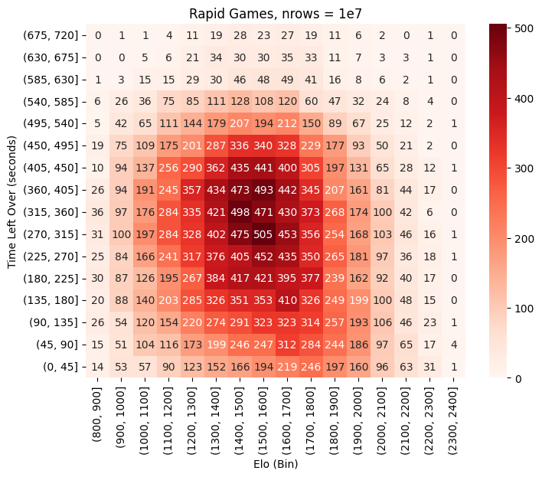
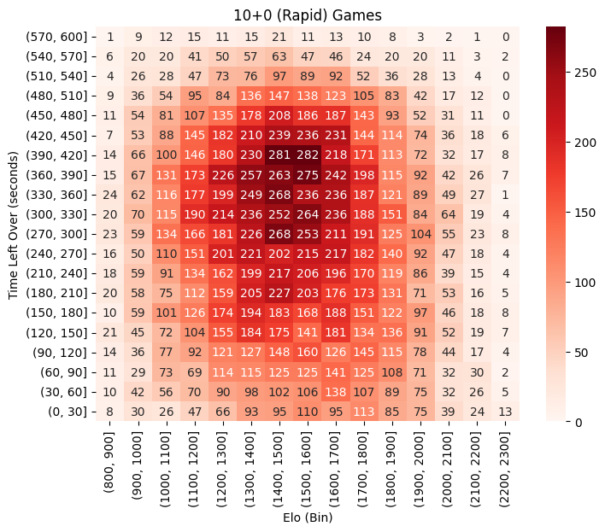
Question 3 - Do more experienced players spend more time thinking?
To measure how much time players spend thinking, we instead consider the complement: how much time is leftover on their clocks when the game ends.
I filtered specifically for Rapid games that were 10+0. Each player starts with 10 minutes and receives 0 seconds of additional time per move made. This second point allows this calculation to be made independent of the length of the game in plies.
We observe a negative correlation between average elo and the clock end of -0.067.

Slide 16
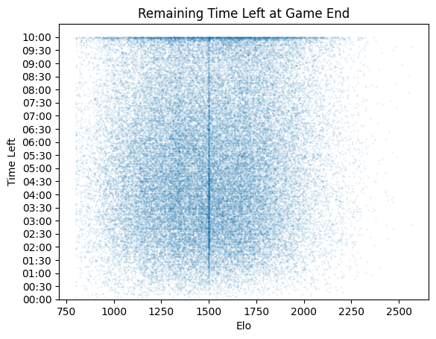
Question 3 - Do more experienced players spend more time thinking?

Slide 17
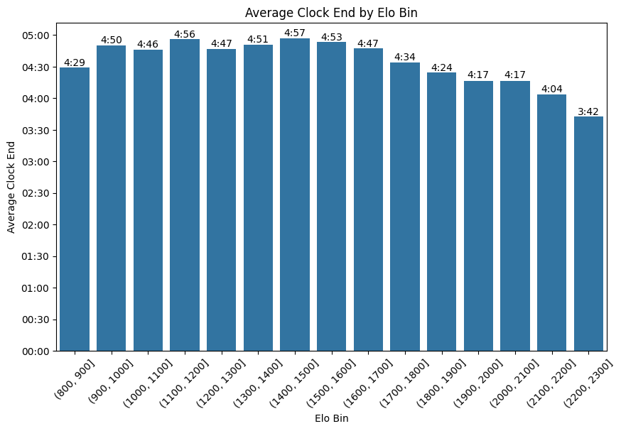
Question 3 - Do more experienced players spend more time thinking?

Slide 18
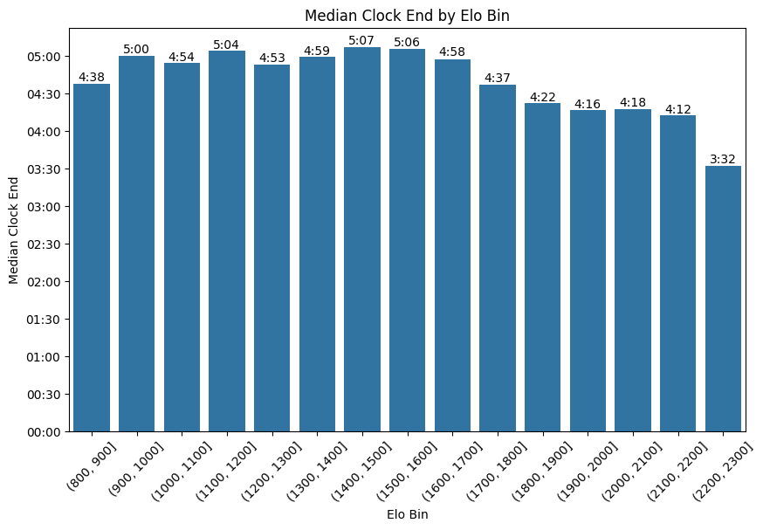
Question 3 - Do more experienced players spend more time thinking?

Slide 19
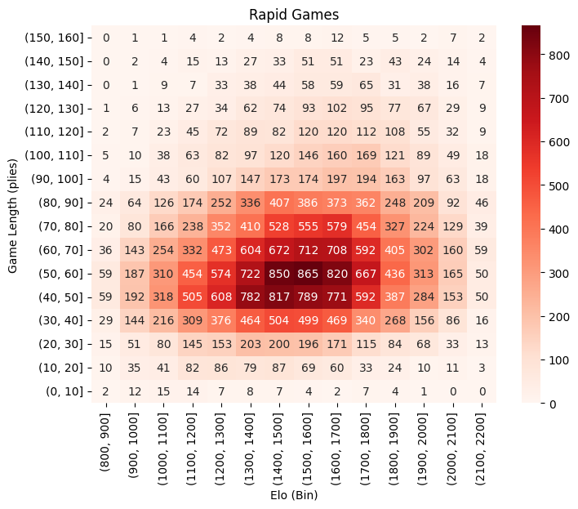
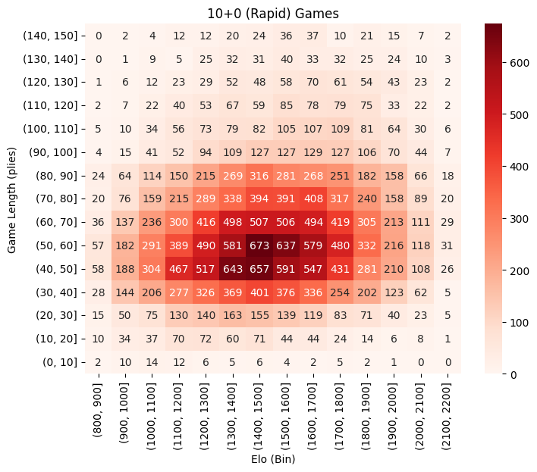
Question 3.1 - Do more experienced players play games that last more moves?
We observe a correlation of 0.1519.

Slide 20
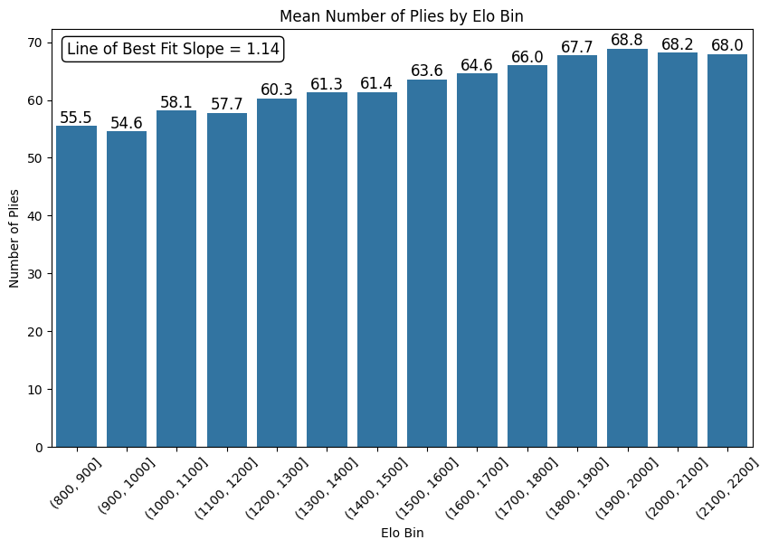
Question 3.1 - Do more experienced players play games that last more moves?

Slide 21
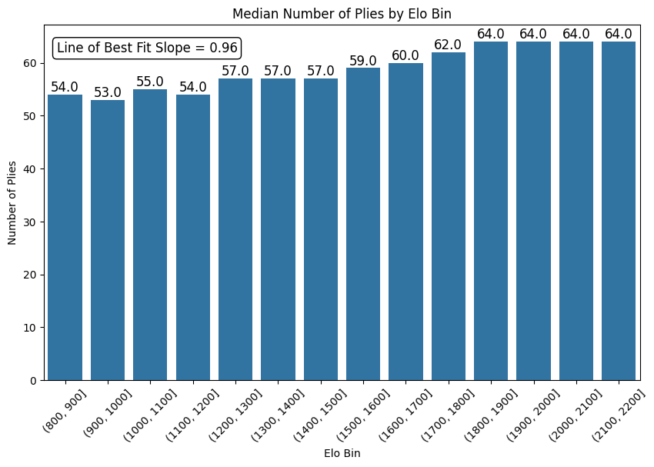
Question 3.1 - Do more experienced players play games that last more moves?

Slide 22
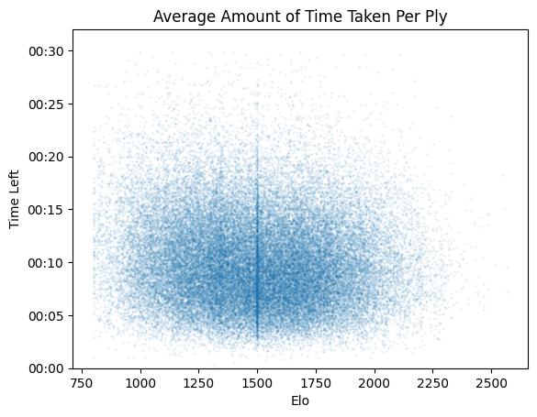
Question 3.2 - Do more experienced players play moves faster?
We observe a correlation of -0.0851.

Slide 23
Question 4:
How often do players who make the first check win the game?

Slide 24
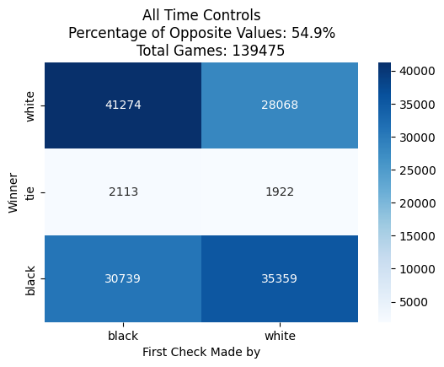
Question 4 - How often do players who make the first check win the game?

Slide 25
Possible Explanations
This result is surprising because the check is one step towards checkmate, the goal of the game
Maybe the check is used as a defensive measure. Chess engines will often play a check if they see that they will be mated as an attempt to extend the game by a move or two, or distract the opponent.
Maybe players are under time pressure.
Maybe the dataset is dominated by lower elo players, who are more likely to check their opponent just because they can.

Slide 26
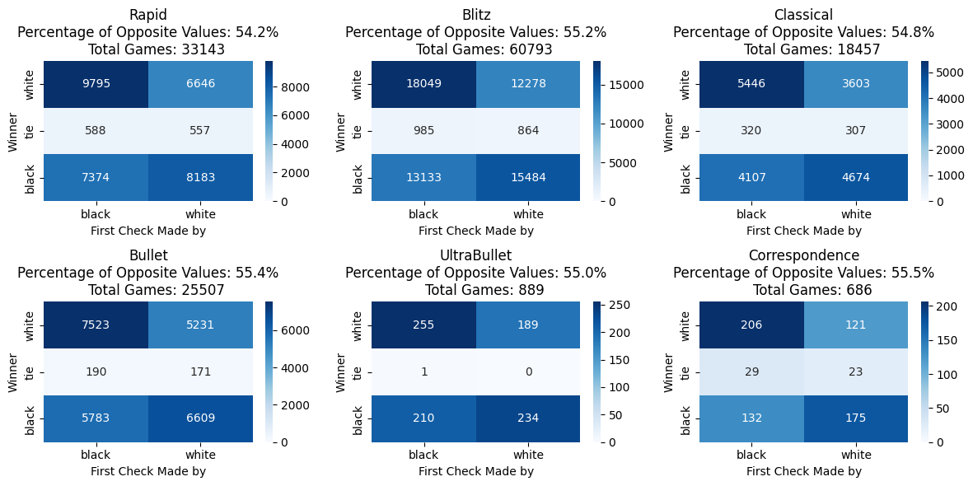
Question 4.1.1 - Is the result consistent upon stratification on time control?

Slide 27
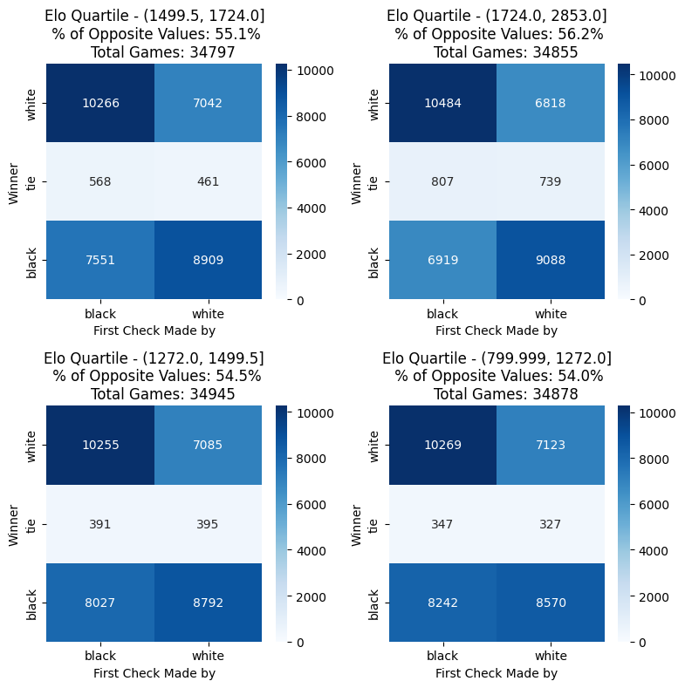
Question 4.1.2 - Is the result consistent upon stratification on elo?
The reality is that the percentage is higher for higher elo players!

Slide 28
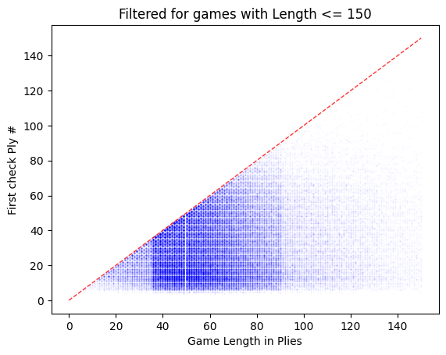
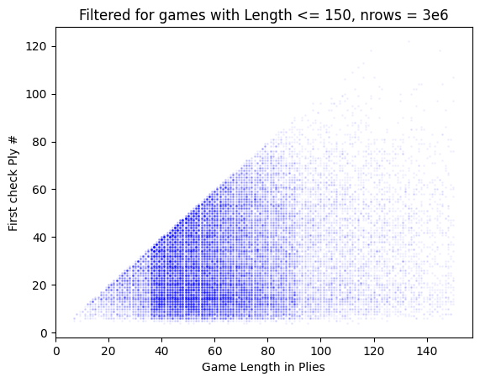
Question 4.2.1 - How often is the first check also linked with the end of the game?

Slide 29
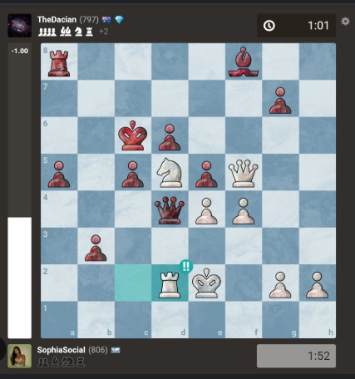
Board Evaluation (Definition)
Speaking of the complexity of the board, the board evaluation is the engine’s evaluation of how much the board state favors either player. An evaluation of 0 means the board is a tie, while a positive evaluation means white has the advantage.
Evaluation is measured in centipawn loss. One centipawn is 1/100 of a pawn.

Slide 30
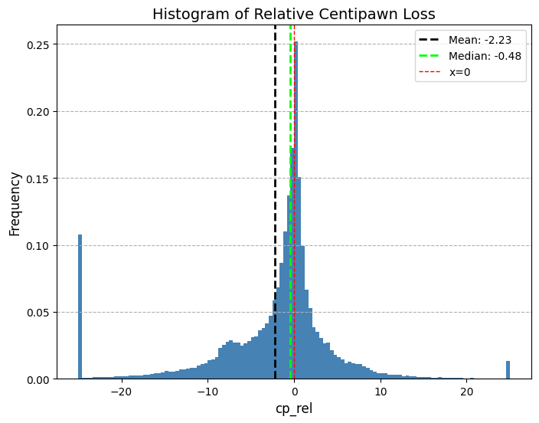
Question 4.2.2 - How often is the first check used as a last ditch effort?
There is an imbalance in the relative evaluation of the board when the first check is made.
The mean and median are both negative, indicating the person making the check tends to be losing (and likely believes they are losing).

Slide 31
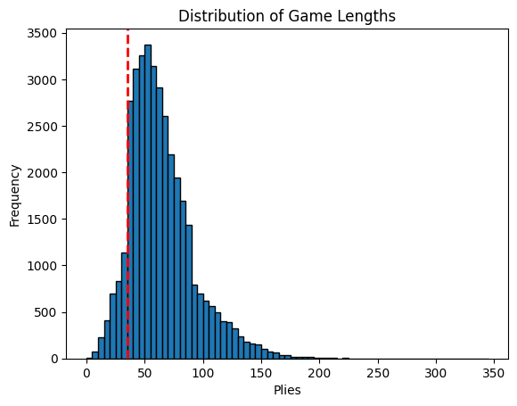
Question 5 - Do more experienced players keep their queens on the board for longer?

Slide 32
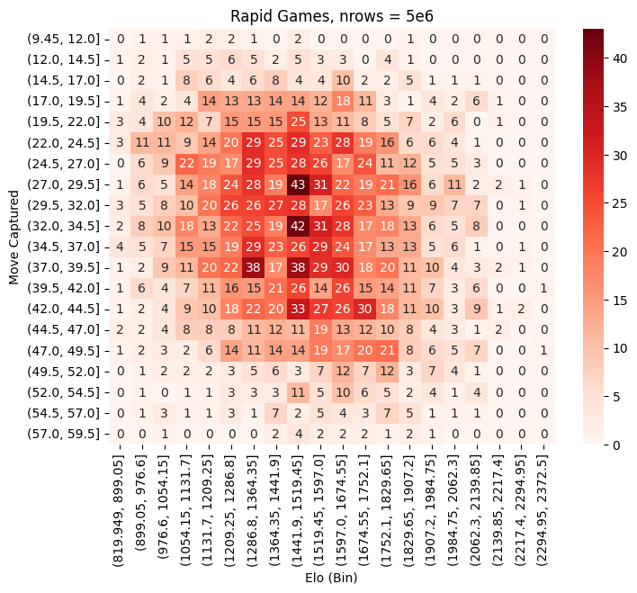
Question 5 - Do more experienced players keep their queens on the board for longer?

Slide 33
Conclusion
I found the following three interesting observations:
In bullet (1+0) games, thinking longer correlates with a higher probability of making a blunder.
In rapid (10+0) games, more experienced players use up more of their clock time.
The player who makes the first check more often than not ends up losing the game.

Slide 34
Thank you!

Slide 35
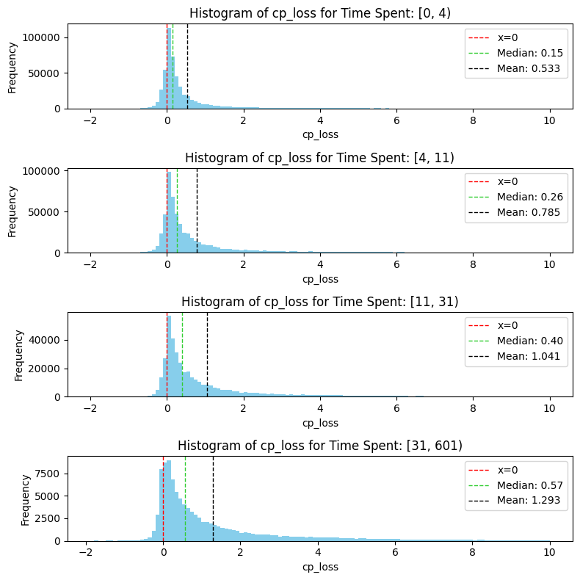
Question 2 - What is the relationship between time spent thinking and the change in evaluation caused by the move?

Slide 36
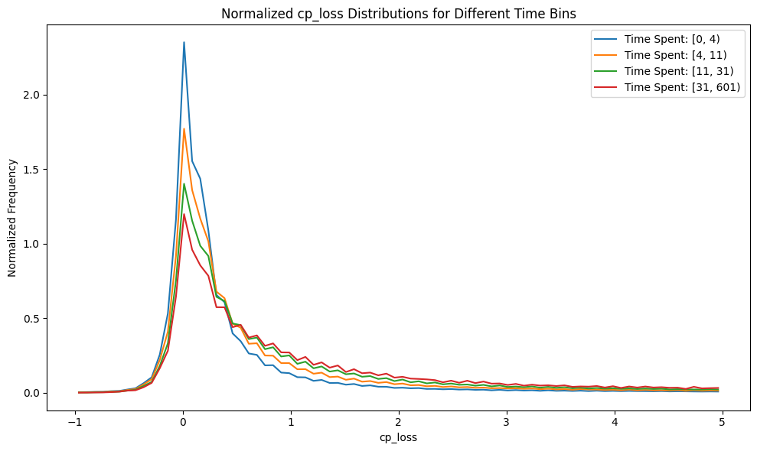
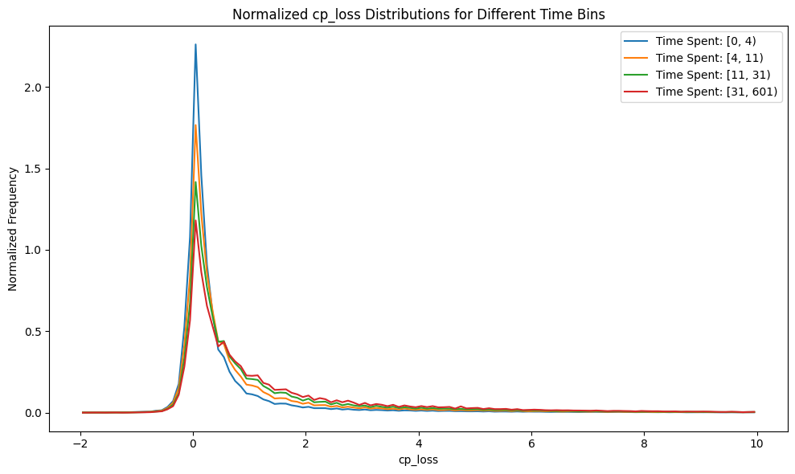
Question 2 - What is the relationship between time spent thinking and the change in evaluation caused by the move?

